Slide 1
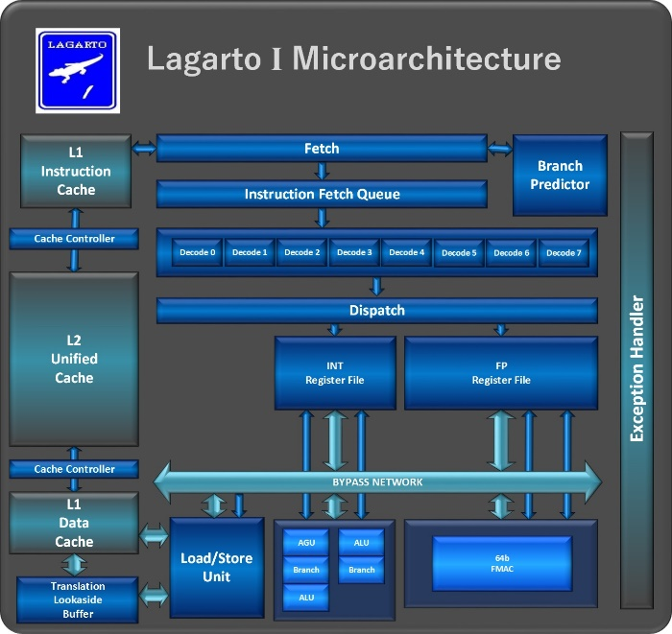
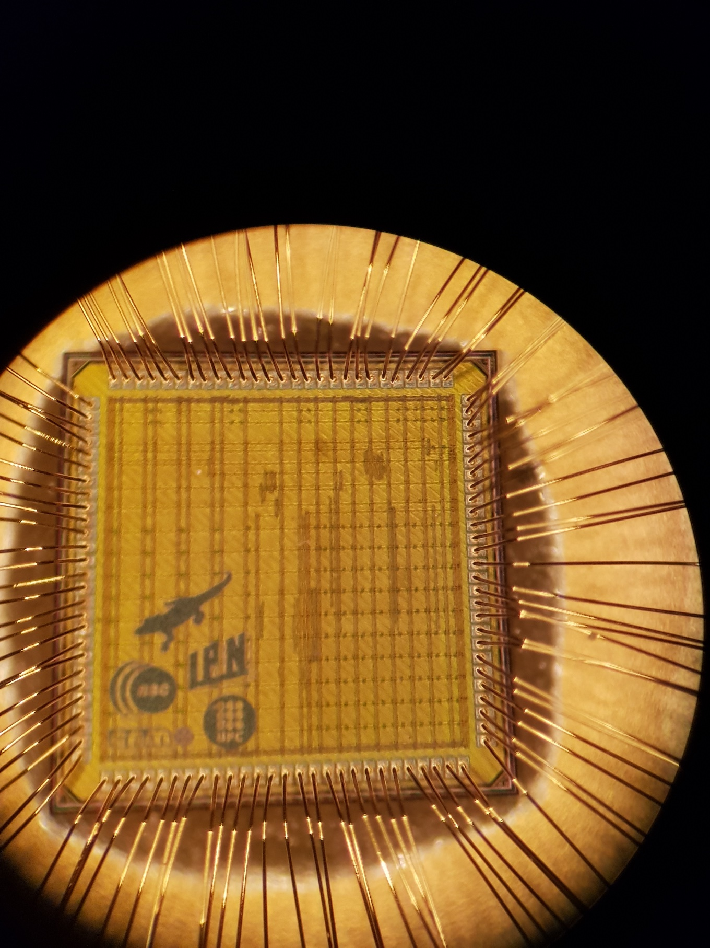
Microarquitectura del Procesador
Lagarto HUN
Microfotografía Lagarto I
45nm TMSC

Slide 2
Microarquitectura Lagarto HUN – RISC-V
Adelantado de valores
(1) | R1 := R2 + R3
(2) | R4 := R1 – R5
(3) | R6 := R1 & R7
(4) | R8 := R1 | R11
FETCH
DECODE
READ REGISTERS
EXECUTE
MEMORY ACCESS
WRITE BACK
Jump
Branch Predictor
IF_flush
Cntrl
ID_flush
RR_flush
EX_flush
MEM_flush
Registros Especiales
LO
Src1
HI
MUX
PC
Decode
Src2
ALU
MUX
MUX
Instruction Memory
rs
Register File
rt
Data
Memory
rs
IF/ID
ID/RR
RR/EX
rt
EX/MEM
MEM/WB
MUX
rd
WriteData
WriteReg
IF/ID_lock
Hazard
ID/RR_lock
Forwarding
RR/EX_lock
PC_lock
EX/MEM_lock
MEME/WB_lock
Microarquitectura de Lagarto I

Slide 3
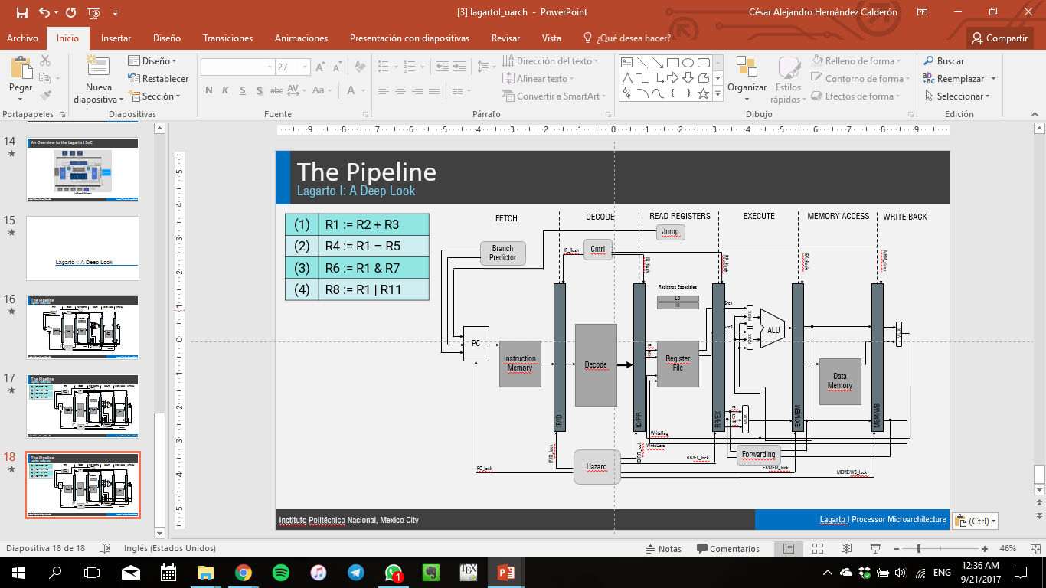
Microarquitectura Lagarto HUN – RISC-V
Adelantado de valores
(1) | R1 := R2 + R3
(2) | R4 := R1 – R5
(3) | R6 := R1 & R7
(4) | R8 := R1 | R11
FETCH
DECODE
READ REGISTERS
EXECUTE
MEMORY ACCESS
WRITE BACK
Jump
Branch Predictor
IF_flush
Cntrl
ID_flush
RR_flush
EX_flush
MEM_flush
Registros Especiales
LO
Src1
HI
MUX
PC
Decode
Src2
ALU
MUX
MUX
Instruction Memory
rs
Register File
rt
Data
Memory
rs
IF/ID
ID/RR
RR/EX
rt
EX/MEM
MEM/WB
MUX
rd
WriteData
WriteReg
IF/ID_lock
Hazard
ID/RR_lock
Forwarding
RR/EX_lock
PC_lock
EX/MEM_lock
MEME/WB_lock
Microarquitectura de Lagarto I

Slide 4
Microarquitectura Lagarto HUN – RISC-V
Adelantado de valores
(1) | R1 := R2 + R3
(2) | R4 := R1 – R5
(3) | R6 := R1 & R7
(4) | R8 := R1 | R11
FETCH
DECODE
READ REGISTERS
EXECUTE
MEMORY ACCESS
WRITE BACK
Jump
Branch Predictor
IF_flush
Cntrl
ID_flush
RR_flush
EX_flush
MEM_flush
Registros Especiales
LO
Src1
HI
MUX
PC
Decode
Src2
ALU
MUX
MUX
Instruction Memory
rs
Register File
rt
Data
Memory
rs
IF/ID
ID/RR
RR/EX
rt
EX/MEM
MEM/WB
MUX
rd
WriteData
WriteReg
IF/ID_lock
Hazard
ID/RR_lock
Forwarding
RR/EX_lock
PC_lock
EX/MEM_lock
MEME/WB_lock
Microarquitectura de Lagarto I

Slide 5
Microarquitectura Lagarto HUN – RISC-V
Adelantado de valores
(1) | R1 := R2 + R3
(2) | R4 := R1 – R5
(3) | R6 := R1 & R7
(4) | R8 := R1 | R11
FETCH
DECODE
READ REGISTERS
EXECUTE
MEMORY ACCESS
WRITE BACK
Jump
Branch Predictor
IF_flush
Cntrl
ID_flush
RR_flush
EX_flush
MEM_flush
Registros Especiales
LO
Src1
HI
MUX
PC
Decode
Src2
ALU
MUX
MUX
Instruction Memory
rs
Register File
rt
Data
Memory
rs
IF/ID
ID/RR
RR/EX
rt
EX/MEM
MEM/WB
MUX
rd
WriteData
WriteReg
IF/ID_lock
Hazard
ID/RR_lock
Forwarding
RR/EX_lock
PC_lock
EX/MEM_lock
MEME/WB_lock
Microarquitectura de Lagarto I

Slide 6
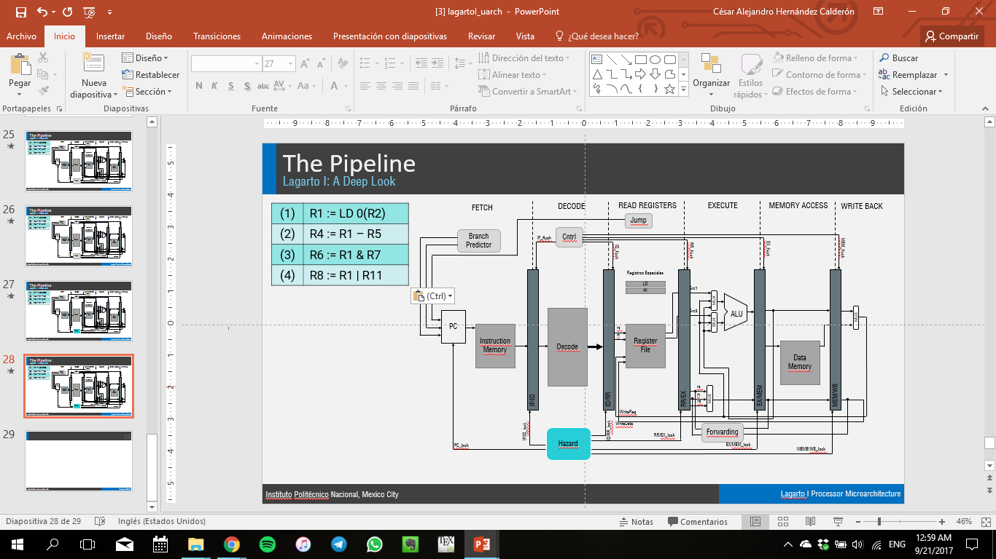
Microarquitectura Lagarto HUN – RISC-V
Adelantado de valores
(1) | R1 := R2 + R3
(2) | R4 := R1 – R5
(3) | R6 := R1 & R7
(4) | R8 := R1 | R11
FETCH
DECODE
READ REGISTERS
EXECUTE
MEMORY ACCESS
WRITE BACK
Jump
Branch Predictor
IF_flush
Cntrl
ID_flush
RR_flush
EX_flush
MEM_flush
Registros Especiales
LO
Src1
HI
MUX
PC
Decode
Src2
ALU
MUX
MUX
Instruction Memory
rs
Register File
rt
Data
Memory
rs
IF/ID
ID/RR
RR/EX
rt
EX/MEM
MEM/WB
MUX
rd
WriteData
WriteReg
IF/ID_lock
Hazard
ID/RR_lock
Forwarding
RR/EX_lock
PC_lock
EX/MEM_lock
MEME/WB_lock
Microarquitectura de Lagarto I

Slide 7
Microarquitectura Lagarto HUN – RISC-V
Adelantado de valores
(1) | R1 := R2 + R3
(2) | R4 := R1 – R5
(3) | R6 := R1 & R7
(4) | R8 := R1 | R11
FETCH
DECODE
READ REGISTERS
EXECUTE
MEMORY ACCESS
WRITE BACK
Jump
Branch Predictor
IF_flush
Cntrl
ID_flush
RR_flush
EX_flush
MEM_flush
Registros Especiales
LO
Src1
HI
MUX
PC
Decode
Src2
ALU
MUX
MUX
Instruction Memory
rs
Register File
rt
Data
Memory
rs
IF/ID
ID/RR
RR/EX
rt
EX/MEM
MEM/WB
MUX
rd
WriteData
ID/RR_lock
IF/ID_lock
Hazard
WriteReg
Forwarding
RR/EX_lock
PC_lock
EX/MEM_lock
MEME/WB_lock
Microarquitectura de Lagarto I

Slide 8
Microarquitectura Lagarto HUN – RISC-V
Adelantado de valores
(1) | R1 := R2 + R3
(2) | R4 := R1 – R5
(3) | R6 := R1 & R7
(4) | R8 := R1 | R11
FETCH
DECODE
READ REGISTERS
EXECUTE
MEMORY ACCESS
WRITE BACK
Jump
Branch Predictor
IF_flush
Cntrl
ID_flush
RR_flush
EX_flush
MEM_flush
Registros Especiales
LO
Src1
HI
MUX
PC
Decode
Src2
ALU
MUX
MUX
Instruction Memory
rs
Register File
rt
Data
Memory
rs
IF/ID
ID/RR
RR/EX
rt
EX/MEM
MEM/WB
MUX
rd
WriteData
WriteReg
IF/ID_lock
Hazard
ID/RR_lock
Forwarding
RR/EX_lock
PC_lock
EX/MEM_lock
MEME/WB_lock
Microarquitectura de Lagarto I

Slide 9
Microarquitectura Lagarto HUN – RISC-V
Adelantado de valores
(1) | R1 := R2 + R3
(2) | R4 := R1 – R5
(3) | R6 := R1 & R7
(4) | R8 := R1 | R11
FETCH
DECODE
READ REGISTERS
EXECUTE
MEMORY ACCESS
WRITE BACK
Jump
Branch Predictor
IF_flush
Cntrl
ID_flush
RR_flush
EX_flush
MEM_flush
Registros Especiales
LO
Src1
HI
MUX
PC
Decode
Src2
ALU
MUX
MUX
Instruction Memory
rs
Register File
rt
Data
Memory
rs
IF/ID
ID/RR
RR/EX
rt
EX/MEM
MEM/WB
MUX
rd
WriteData
WriteReg
IF/ID_lock
Hazard
ID/RR_lock
Forwarding
RR/EX_lock
PC_lock
EX/MEM_lock
MEME/WB_lock
Microarquitectura de Lagarto I

Slide 10
Microarquitectura Lagarto HUN – RISC-V
Adelantado de valores
(1) | R1 := R2 + R3
(2) | R4 := R1 – R5
(3) | R6 := R1 & R7
(4) | R8 := R1 | R11
FETCH
DECODE
READ REGISTERS
EXECUTE
MEMORY ACCESS
WRITE BACK
Jump
Branch Predictor
IF_flush
Cntrl
ID_flush
RR_flush
EX_flush
MEM_flush
Registros Especiales
LO
Src1
HI
MUX
PC
Decode
Src2
ALU
MUX
MUX
Instruction Memory
rs
Register File
rt
Data
Memory
rs
IF/ID
ID/RR
RR/EX
rt
EX/MEM
MEM/WB
MUX
rd
WriteData
WriteReg
IF/ID_lock
Hazard
ID/RR_lock
Forwarding
RR/EX_lock
PC_lock
EX/MEM_lock
MEME/WB_lock
Microarquitectura de Lagarto I

Slide 11
Microarquitectura Lagarto HUN – RISC-V
Dependencia de datos
(1) | R1 := LD 0(R2)
(2) | R4 := R1 – R5
(3) | R6 := R1 & R7
(4) | R8 := R1 | R11
FETCH
DECODE
READ REGISTERS
EXECUTE
MEMORY ACCESS
WRITE BACK
Jump
Branch Predictor
IF_flush
Cntrl
ID_flush
RR_flush
EX_flush
MEM_flush
Registros Especiales
LO
Src1
HI
MUX
PC
Decode
Src2
ALU
MUX
MUX
Instruction Memory
rs
Register File
rt
Data
Memory
rs
IF/ID
ID/RR
RR/EX
rt
EX/MEM
MEM/WB
MUX
rd
WriteData
WriteReg
IF/ID_lock
Hazard
ID/RR_lock
Forwarding
RR/EX_lock
PC_lock
EX/MEM_lock
MEME/WB_lock
Microarquitectura de Lagarto I

Slide 12
Microarquitectura Lagarto HUN – RISC-V
Dependencia de datos
(1) | R1 := LD 0(R2)
(2) | R4 := R1 – R5
(3) | R6 := R1 & R7
(4) | R8 := R1 | R11
FETCH
DECODE
READ REGISTERS
EXECUTE
MEMORY ACCESS
WRITE BACK
Jump
Branch Predictor
IF_flush
Cntrl
ID_flush
RR_flush
EX_flush
MEM_flush
Registros Especiales
LO
Src1
HI
MUX
PC
Decode
Src2
ALU
MUX
MUX
Instruction Memory
rs
Register File
rt
Data
Memory
rs
IF/ID
ID/RR
RR/EX
rt
EX/MEM
MEM/WB
MUX
rd
WriteData
WriteReg
IF/ID_lock
Hazard
ID/RR_lock
Forwarding
RR/EX_lock
PC_lock
EX/MEM_lock
MEME/WB_lock
Microarquitectura de Lagarto I

Slide 13
Microarquitectura Lagarto HUN – RISC-V
Dependencia de datos
(1) | R1 := LD 0(R2)
(2) | R4 := R1 – R5
(3) | R6 := R1 & R7
(4) | R8 := R1 | R11
FETCH
DECODE
READ REGISTERS
EXECUTE
MEMORY ACCESS
WRITE BACK
Jump
Branch Predictor
IF_flush
Cntrl
ID_flush
RR_flush
EX_flush
MEM_flush
Registros Especiales
LO
Src1
HI
MUX
PC
Decode
Src2
ALU
MUX
MUX
Instruction Memory
rs
Register File
rt
Data
Memory
rs
IF/ID
ID/RR
RR/EX
rt
EX/MEM
MEM/WB
MUX
rd
WriteData
WriteReg
IF/ID_lock
Hazard
ID/RR_lock
Forwarding
RR/EX_lock
PC_lock
EX/MEM_lock
MEME/WB_lock
Microarquitectura de Lagarto I

Slide 14
Microarquitectura Lagarto HUN – RISC-V
Dependencia de datos
(1) | R1 := LD 0(R2)
(2) | R4 := R1 – R5
(3) | R6 := R1 & R7
(4) | R8 := R1 | R11
FETCH
DECODE
READ REGISTERS
EXECUTE
MEMORY ACCESS
WRITE BACK
Jump
Branch Predictor
IF_flush
Cntrl
ID_flush
RR_flush
EX_flush
MEM_flush
Registros Especiales
LO
Src1
HI
MUX
PC
Decode
Src2
ALU
MUX
MUX
Instruction Memory
rs
Register File
rt
Data
Memory
rs
IF/ID
ID/RR
RR/EX
rt
EX/MEM
MEM/WB
MUX
rd
WriteData
WriteReg
IF/ID_lock
Hazard
ID/RR_lock
Forwarding
RR/EX_lock
PC_lock
EX/MEM_lock
MEME/WB_lock
Microarquitectura de Lagarto I

Slide 15
Microarquitectura Lagarto HUN – RISC-V
Dependencia de datos
(1) | R1 := LD 0(R2)
(2) | R4 := R1 – R5
(3) | R6 := R1 & R7
(4) | R8 := R1 | R11
FETCH
DECODE
READ REGISTERS
EXECUTE
MEMORY ACCESS
WRITE BACK
Jump
Branch Predictor
IF_flush
Cntrl
ID_flush
RR_flush
EX_flush
MEM_flush
Registros Especiales
LO
Src1
HI
MUX
PC
Decode
Src2
ALU
MUX
MUX
Instruction Memory
rs
Register File
rt
Data
Memory
rs
IF/ID
ID/RR
RR/EX
rt
EX/MEM
MEM/WB
MUX
rd
WriteData
WriteReg
IF/ID_lock
Hazard
ID/RR_lock
Forwarding
RR/EX_lock
PC_lock
EX/MEM_lock
MEME/WB_lock
Microarquitectura de Lagarto I

Slide 16
Microarquitectura Lagarto HUN – RISC-V
Dependencia de datos
(1) | R1 := LD 0(R2)
(2) | R4 := R1 – R5
(3) | R6 := R1 & R7
(4) | R8 := R1 | R11
FETCH
DECODE
READ REGISTERS
EXECUTE
MEMORY ACCESS
WRITE BACK
Jump
Branch Predictor
IF_flush
Cntrl
ID_flush
RR_flush
EX_flush
MEM_flush
Registros Especiales
LO
Src1
HI
MUX
PC
Decode
Src2
ALU
MUX
MUX
Instruction Memory
rs
Register File
rt
Data
Memory
rs
IF/ID
ID/RR
RR/EX
rt
EX/MEM
MEM/WB
MUX
rd
WriteData
WriteReg
IF/ID_lock
Hazard
ID/RR_lock
Forwarding
RR/EX_lock
PC_lock
EX/MEM_lock
MEME/WB_lock
Microarquitectura de Lagarto I

Slide 17
Microarquitectura Lagarto HUN – RISC-V
Dependencia de datos
(1) | R1 := LD 0(R2)
(2) | R4 := R1 – R5
(3) | R6 := R1 & R7
(4) | R8 := R1 | R11
FETCH
DECODE
READ REGISTERS
EXECUTE
MEMORY ACCESS
WRITE BACK
Jump
Branch Predictor
IF_flush
Cntrl
ID_flush
RR_flush
EX_flush
MEM_flush
Registros Especiales
LO
Src1
HI
MUX
PC
Decode
Src2
ALU
MUX
MUX
Instruction Memory
rs
Register File
rt
Data
Memory
rs
IF/ID
ID/RR
RR/EX
rt
EX/MEM
MEM/WB
MUX
rd
WriteData
WriteReg
IF/ID_lock
Hazard
ID/RR_lock
Forwarding
RR/EX_lock
PC_lock
EX/MEM_lock
MEME/WB_lock
Microarquitectura de Lagarto I

Slide 18
Microarquitectura Lagarto HUN – RISC-V
Dependencia de datos
(1) | R1 := LD 0(R2)
(2) | R4 := R1 – R5
(3) | R6 := R1 & R7
(4) | R8 := R1 | R11
FETCH
DECODE
READ REGISTERS
EXECUTE
MEMORY ACCESS
WRITE BACK
Jump
Branch Predictor
IF_flush
Cntrl
ID_flush
RR_flush
EX_flush
MEM_flush
Registros Especiales
LO
Src1
HI
MUX
PC
Decode
Src2
ALU
MUX
MUX
Instruction Memory
rs
Register File
rt
Data
Memory
rs
IF/ID
ID/RR
RR/EX
rt
EX/MEM
MEM/WB
MUX
rd
WriteData
WriteReg
IF/ID_lock
Hazard
ID/RR_lock
Forwarding
RR/EX_lock
PC_lock
EX/MEM_lock
MEME/WB_lock
Microarquitectura de Lagarto I

Slide 19
Microarquitectura Lagarto HUN – RISC-V
Predictor de saltos
FETCH
DECODE
READ REGISTERS
EXECUTE
MEMORY ACCESS
WRITE BACK
Jump
Branch Predictor
IF_flush
Cntrl
ID_flush
RR_flush
EX_flush
MEM_flush
Registros Especiales
LO
Src1
HI
MUX
PC
Decode
Src2
ALU
MUX
Instruction Memory
rs
Register File
MUX
rt
Data
Memory
rs
IF/ID
ID/RR
RR/EX
rt
EX/MEM
MEM/WB
MUX
rd
WriteData
IF/ID_lock
Hazard
ID/RR_lock
Write Reg
Forwarding
RR/EX_lock
PC_lock
EX/MEM_lock
MEME/WB_lock
El predictor de saltos es un circuito especializado para optimizar la ejecución de instrucciones que consume una cantidad considerable de energía. Algunos procesadores modernos predictores simples para reducir el consumo de energía y área.
Predicción estática:
Predicción trivial
Predicción dinámica
Branch History Table (BHT)
Branch Target Buffer (BTB)
Ejemplos:
Bimodal
Local
Global (Gshare)
Híbridos

Slide 20
Microarquitectura Lagarto HUN – RISC-V
Predictor de saltos
SEGMENTO DE CÓDIGO
Instrucción | PC | Comentarios
lw a0, 0x4000(zero) #0000 carga cero al registro a0 para acumular el resultado
lw a2, 0x4004(zero) #0004 carga un elemento de la matriz 1
lw a3, 0x4008(zero) #0008 carga un elemento de la matriz 2
lw a4, 0x400c(zero) #000c carga el valor 1 al registro a4 para decrementar el acumulador
lw ra, 0x4010(zero) #0010 carga la dirección de retorno
j multiply #0014 salta a la función multiply
multiply: # regresa el valor de la multiplicación a través del registro a0
add a0,a0,a2 #0088
sub a3,a3,a4 #008c el valor del registro a4 (1) es usado como variable auxiliar
beq a3,zero, return #0090
j multiply #0094
return:
jr ra #0098 regresa al programa que invocó la función

Slide 21
Microarquitectura Lagarto HUN – RISC-V
Predictor de saltos
SEGMENTO DE CÓDIGO
Instrucción | PC
lw a0, 0x4000(zero) #0000
lw a2, 0x4004(zero) #0004
lw a3, 0x4008(zero) #0008
lw a4, 0x400c(zero) #000c
lw ra, 0x4010(zero) #0010
j multiply #0014
multiply:
add a0,a0,a2 #0088
sub a3,a3,a4 #008c
beq a3,zero, return #0090
j multiply #0094
return:
jr ra #0098
FETCH
DECODE
READ REGISTERS
EXECUTE
MEMORY ACCESS
WRITE BACK
Jump
Branch Predictor
IF_flush
Cntrl
ID_flush
RR_flush
EX_flush
MEM_flush
Registros Especiales
LO
Src1
HI
MUX
PC
Decode
Src2
ALU
MUX
Instruction Memory
rs
Register File
MUX
rt
Data
Memory
rs
IF/ID
ID/RR
RR/EX
rt
EX/MEM
MEM/WB
MUX
rd
WriteData
IF/ID_lock
Hazard
ID/RR_lock
Write Reg
Forwarding
RR/EX_lock
PC_lock
EX/MEM_lock
MEME/WB_lock

Slide 22
Microarquitectura Lagarto HUN – RISC-V
Predictor de saltos
Tablas de predicción
Instruction PC
[31:12]
[11:2]
[1:0]
Máquina de Estados Finitos de Confianza
Branch Instruction PC
PHT
Branch Target Buffer
0xh0000000
00
0xh0000000
NO TAKEN
MISS
MISS
HIT
TAKEN
0xh0000000
00
0xh0000000
0xh0000000
00
0xh0000000
00
01
10
11
0xh0000000
00
0xh0000000
0xh0000000
00
0xh0000000
…
…
…
HIT
HIT
0xh0000000
00
0xh0000000
HIT
MISS
MISS
=
T/NT
Branch Target Address
Is a Branch?
Microarquitectura lagarto I

Slide 23
Microarquitectura Lagarto HUN – RISC-V
Predictor de saltos
Tablas de predicción
Instruction PC
[31:12]
[11:2]
[1:0]
Máquina de Estados Finitos de Confianza
Branch Instruction PC
PHT
Branch Target Buffer
0xh0000000
00
0xh0000000
NO TAKEN
MISS
MISS
HIT
TAKEN
0xh0000000
00
0xh0000000
0xh0000000
00
0xh0000000
00
01
10
11
0xh0000000
00
0xh0000000
0xh0000000
00
0xh0000000
…
…
…
HIT
HIT
0xh0000000
00
0xh0000000
HIT
MISS
MISS
=
T/NT
Branch Target Address
Is a Branch?
Microarquitectura lagarto I

Slide 24
Microarquitectura Lagarto HUN – RISC-V
Predictor de saltos
Tablas de predicción
Instruction PC
[31:12]
[11:2]
[1:0]
Máquina de Estados Finitos de Confianza
Branch Instruction PC
PHT
Branch Target Buffer
0xh0000000
00
0xh0000000
NO TAKEN
MISS
MISS
HIT
TAKEN
0xh0000000
00
0xh0000000
0xh0000000
00
0xh0000000
00
01
10
11
0xh0000000
00
0xh0000000
0xh0000000
00
0xh0000000
…
…
…
HIT
HIT
0xh0000000
00
0xh0000000
HIT
MISS
MISS
=
T/NT
Branch Target Address
Is a Branch?
Microarquitectura lagarto I

Slide 25
Microarquitectura Lagarto HUN – RISC-V
Predictor de saltos
Tablas de predicción
Instruction PC
[31:12]
[11:2]
[1:0]
Máquina de Estados Finitos de Confianza
Branch Instruction PC
PHT
Branch Target Buffer
0xh0000000
00
0xh0000000
NO TAKEN
MISS
MISS
HIT
TAKEN
0xh0000000
00
0xh0000000
0xh0000000
00
0xh0000000
00
01
10
11
0xh0000000
00
0xh0000000
0xh0000000
00
0xh0000000
…
…
…
HIT
HIT
0xh0000000
00
0xh0000000
HIT
MISS
MISS
=
T/NT
Branch Target Address
Is a Branch?
Microarquitectura del Lagarto I

Slide 26
Microarquitectura Lagarto HUN – RISC-V
Predictor de saltos
Tablas de predicción
Instruction PC
[31:12]
[11:2]
[1:0]
Máquina de Estados Finitos de Confianza
Branch Instruction PC
PHT
Branch Target Buffer
0xh0000000
00
0xh0000000
NO TAKEN
MISS
MISS
HIT
TAKEN
0xh0000000
00
0xh0000000
0xh0000000
00
0xh0000000
00
01
10
11
0xh0000000
00
0xh0000000
0xh0000000
00
0xh0000000
…
…
…
HIT
HIT
0xh0000000
00
0xh0000000
HIT
MISS
MISS
=
T/NT
Branch Target Address
Is a Branch?
Microarquitectura del Lagarto I

Slide 27
Microarquitectura Lagarto HUN – RISC-V
Predictor bimodal
Tablas de predicción
Instruction PC
[31:12]
[11:2]
[1:0]
Máquina de Estados Finitos de Confianza
Branch Instruction PC
PHT
Branch Target Buffer
0xh0000000
00
0xh0000000
NO TAKEN
MISS
MISS
HIT
TAKEN
0xh0000000
00
0xh0000000
0xh0000000
00
0xh0000000
00
01
10
11
0xh0000000
00
0xh0000000
0xh0000000
00
0xh0000000
…
…
…
HIT
HIT
0xh0000000
00
0xh0000000
HIT
MISS
MISS
=
T/NT
Branch Target Address
Is a Branch?
Microarquitectura Lagarto I

Slide 28
Microarquitectura Lagarto HUN – RISC-V
Predictor bimodal
Tablas de predicción
Instruction PC
[31:12]
[11:2]
[1:0]
Máquina de Estados Finitos de Confianza
Branch Instruction PC
PHT
Branch Target Buffer
0xh0000000
00
0xh0000000
NO TAKEN
MISS
MISS
HIT
TAKEN
0xh0000000
00
0xh0000000
0xh0000000
00
0xh0000000
00
01
10
11
0xh0000000
00
0xh0000000
0xh0000000
00
0xh0000000
…
…
…
HIT
HIT
0xh0000000
00
0xh0000000
HIT
MISS
MISS
=
T/NT
Branch Target Address
Is a Branch?
Microarquitectura Lagarto I

Slide 29
Microarquitectura Lagarto HUN – RISC-V
Predictor bimodal
Tablas de predicción
Instruction PC
[31:12]
[11:2]
[1:0]
Máquina de Estados Finitos de Confianza
Branch Instruction PC
PHT
Branch Target Buffer
0xh0000000
00
0xh0000000
NO TAKEN
MISS
MISS
HIT
TAKEN
0xh0000000
00
0xh0000000
0xh0000000
00
0xh0000000
00
01
10
11
0xh0000000
00
0xh0000000
0xh0000000
00
0xh0000000
…
…
…
HIT
HIT
0xh0000000
00
0xh0000000
HIT
MISS
MISS
=
T/NT
Branch Target Address
Is a Branch?
Microarquitectura Lagarto I

Slide 30
Microarquitectura Lagarto HUN – RISC-V
Predictor bimodal
Tablas de predicción
Instruction PC
[31:12]
[11:2]
[1:0]
Máquina de Estados Finitos de Confianza
Branch Instruction PC
PHT
Branch Target Buffer
0xh0000000
00
0xh0000000
NO TAKEN
MISS
MISS
HIT
TAKEN
0xh0000000
00
0xh0000000
0xh0000000
00
0xh0000000
00
01
10
11
0xh0000000
00
0xh0000000
0xh0000000
00
0xh0000000
…
…
…
HIT
HIT
0xh0000000
00
0xh0000000
HIT
MISS
MISS
=
T/NT
Branch Target Address
Is a Branch?
Microarquitectura Lagarto I

Slide 31
Microarquitectura Lagarto HUN – RISC-V
Predictor bimodal
Instruction PC
[31:12]
[11:2]
[1:0]
CODE SEGMENT
Instruction | PC
lw $v0, 0x4000($0) #0000
lw $a0, 0x4004($0) #0004
lw $a1, 0x4008($0) #0008
lw $a2, 0x400c($0) #000c
lw $ra, 0x4010($0) #0010
j multiply #0014
.
.
.
multiply:
add a0,a0,a2 #0088
sub a3,a3,a4 #008c
beq a3,zero, return #0090
j multiply #0094
return:
jr ra #0098
Branch Instruction PC
PHT
Branch Target Buffer
0xh00000
00
0xh00000000
0xh00000
00
0xh00000000
FETCH
DECODE
READ REGISTERS
EXECUTE
MEMORY ACCESS
WRITE BACK
0xh00000
00
0xh00000000
Jump
0xh00000
00
0xh00000000
Branch Predictor
IF_flush
Cntrl
0xh00000
00
0xh00000000
RR_flush
EX_flush
MEM_flush
…
…
…
ID_flush
0xh00000
00
0xh00000000
Special Registers
LO
Src1
=
T/NT
Branch Target Address
HI
MUX
Is a Branch?
PC
Decode
Src2
ALU
MUX
Instruction Memory
rs
Register File
MUX
rt
Data
Memory
a2 = 5
a3 = 6
a4 = 1
a0 = 0
rs
IF/ID
ID/RR
RR/EX
rt
EX/MEM
MEM/WB
MUX
rd
WriteData
IF/ID_lock
Hazard
ID/RR_lock
Write Reg
Forwarding
RR/EX_lock
PC_lock
EX/MEM_lock
MEME/WB_lock
add a0,a0,a2
Microarquitectura Lagarto I

Slide 32
Microarquitectura Lagarto HUN – RISC-V
Predictor bimodal
Instruction PC
[31:12]
[11:2]
[1:0]
CODE SEGMENT
Instruction | PC
lw $v0, 0x4000($0) #0000
lw $a0, 0x4004($0) #0004
lw $a1, 0x4008($0) #0008
lw $a2, 0x400c($0) #000c
lw $ra, 0x4010($0) #0010
j multiply #0014
.
.
.
multiply:
add a0,a0,a2 #0088
sub a3,a3,a4 #008c
beq a3,zero, return #0090
j multiply #0094
return:
jr ra #0098
Branch Instruction PC
PHT
Branch Target Buffer
0xh00000
00
0xh00000000
0xh00000
00
0xh00000000
FETCH
DECODE
READ REGISTERS
EXECUTE
MEMORY ACCESS
WRITE BACK
0xh00000
00
0xh00000000
Jump
0xh00000
00
0xh00000000
Branch Predictor
IF_flush
Cntrl
0xh00000
00
0xh00000000
EX_flush
MEM_flush
…
…
…
ID_flush
RR_flush
0xh00000
00
0xh00000000
Special Registers
LO
Src1
=
T/NT
Branch Target Address
HI
MUX
Is a Branch?
PC
Decode
Src2
ALU
MUX
Instruction Memory
rs
Register File
MUX
rt
Data
Memory
a2 = 5
a3 = 6
a4 = 1
a0 = 0
rs
IF/ID
ID/RR
RR/EX
rt
EX/MEM
MEM/WB
MUX
rd
WriteData
IF/ID_lock
Hazard
ID/RR_lock
Write Reg
Forwarding
RR/EX_lock
PC_lock
EX/MEM_lock
MEME/WB_lock
sub a3,a3,a4
add a0,a0,a2
Microarquitectura Lagarto I

Slide 33
Microarquitectura Lagarto HUN – RISC-V
Predictor bimodal
Instruction PC
[31:12]
[11:2]
[1:0]
CODE SEGMENT
Instruction | PC
lw $v0, 0x4000($0) #0000
lw $a0, 0x4004($0) #0004
lw $a1, 0x4008($0) #0008
lw $a2, 0x400c($0) #000c
lw $ra, 0x4010($0) #0010
j multiply #0014
.
.
.
multiply:
add a0,a0,a2 #0088
sub a3,a3,a4 #008c
beq a3,zero, return #0090
j multiply #0094
return:
jr ra #0098
Branch Instruction PC
PHT
Branch Target Buffer
0xh00000
00
0xh00000000
0xh00000
00
0xh00000000
FETCH
DECODE
READ REGISTERS
EXECUTE
MEMORY ACCESS
WRITE BACK
0xh00000
00
0xh00000000
Jump
0xh00000
00
0xh00000000
Branch Predictor
IF_flush
Cntrl
0xh00000
00
0xh00000000
EX_flush
MEM_flush
…
…
…
ID_flush
RR_flush
0xh00000
00
0xh00000000
Special Registers
LO
Src1
=
T/NT
Branch Target Address
HI
MUX
Is a Branch?
PC
Decode
Src2
ALU
MUX
Instruction Memory
rs
Register File
MUX
rt
Data
Memory
a2 = 5
a3 = 6
a4 = 1
a0 = 0
rs
IF/ID
ID/RR
RR/EX
rt
EX/MEM
MEM/WB
MUX
rd
WriteData
IF/ID_lock
Hazard
ID/RR_lock
Write Reg
Forwarding
RR/EX_lock
PC_lock
EX/MEM_lock
MEME/WB_lock
beq a3,zero,return
sub a3,a3,a4
add a0.a0.a2
Microarquitectura Lagarto I

Slide 34
Microarquitectura Lagarto HUN – RISC-V
Predictor bimodal
Instruction PC
[31:12]
[11:2]
[1:0]
CODE SEGMENT
Instruction | PC
lw $v0, 0x4000($0) #0000
lw $a0, 0x4004($0) #0004
lw $a1, 0x4008($0) #0008
lw $a2, 0x400c($0) #000c
lw $ra, 0x4010($0) #0010
j multiply #0014
.
.
.
multiply:
add a0,a0,a2 #0088
sub a3,a3,a4 #008c
beq a3,zero, return #0090
j multiply #0094
return:
jr ra #0098
Branch Instruction PC
PHT
Branch Target Buffer
0xh00000
00
0xh00000000
0xh00000
00
0xh00000000
FETCH
DECODE
READ REGISTERS
EXECUTE
MEMORY ACCESS
WRITE BACK
0xh00000
00
0xh00000000
Jump
0xh00000
00
0xh00000000
Branch Predictor
IF_flush
Cntrl
0xh00000
00
0xh00000000
EX_flush
MEM_flush
…
…
…
ID_flush
RR_flush
0xh00000
00
0xh00000000
Special Registers
LO
Src1
=
T/NT
Branch Target Address
HI
MUX
Is a Branch?
PC
Decode
Src2
ALU
MUX
Instruction Memory
rs
Register File
MUX
rt
Data
Memory
a2 = 5
a3 = 6
a4 = 1
a0 = 0
rs
IF/ID
ID/RR
RR/EX
rt
EX/MEM
MEM/WB
MUX
rd
WriteData
IF/ID_lock
Hazard
ID/RR_lock
Write Reg
Forwarding
RR/EX_lock
PC_lock
EX/MEM_lock
MEME/WB_lock
nop
beq a3,zero,return
sub a3,a3,a4
add a0,a0,a2
Microarquitectura Lagarto I

Slide 35
Microarquitectura Lagarto HUN – RISC-V
Predictor bimodal
Instruction PC
[31:12]
[11:2]
[1:0]
CODE SEGMENT
Instruction | PC
lw $v0, 0x4000($0) #0000
lw $a0, 0x4004($0) #0004
lw $a1, 0x4008($0) #0008
lw $a2, 0x400c($0) #000c
lw $ra, 0x4010($0) #0010
j multiply #0014
.
.
.
multiply:
add a0,a0,a2 #0088
sub a3,a3,a4 #008c
beq a3,zero, return #0090
j multiply #0094
return:
jr ra #0098
Branch Instruction PC
PHT
Branch Target Buffer
0xh00000
00
0xh00000000
0xh00000
00
0xh00000000
FETCH
DECODE
READ REGISTERS
EXECUTE
MEMORY ACCESS
WRITE BACK
0xh00000
00
0xh00000000
Jump
0xh00000
00
0xh00000000
Branch Predictor
IF_flush
Cntrl
0xh00000
00
0xh00000000
EX_flush
MEM_flush
…
…
…
ID_flush
RR_flush
0xh00000
00
0xh00000000
Special Registers
LO
Src1
=
T/NT
Branch Target Address
HI
MUX
Is a Branch?
PC
Decode
Src2
ALU
MUX
Instruction Memory
rs
Register File
MUX
rt
Data
Memory
a2 = 5
a3 = 6
a4 = 1
a0 = 0
rs
IF/ID
ID/RR
RR/EX
rt
EX/MEM
MEM/WB
MUX
rd
WriteData
IF/ID_lock
Hazard
ID/RR_lock
Write Reg
Forwarding
RR/EX_lock
PC_lock
EX/MEM_lock
MEME/WB_lock
j multiply
nop
beq a3,zero,return
sub a3,a3,a4
add a0,a0,a2
Microarquitectura Lagarto I

Slide 36
Microarquitectura Lagarto HUN – RISC-V
Predictor bimodal
NO TAKEN
MISS
MISS
HIT
TAKEN
Instruction PC
[31:12]
[11:2]
[1:0]
00
01
10
11
CODE SEGMENT
Instruction | PC
lw $v0, 0x4000($0) #0000
lw $a0, 0x4004($0) #0004
lw $a1, 0x4008($0) #0008
lw $a2, 0x400c($0) #000c
lw $ra, 0x4010($0) #0010
j multiply #0014
.
.
.
multiply:
add a0,a0,a2 #0088
sub a3,a3,a4 #008c
beq a3,zero, return #0090
j multiply #0094
return:
jr ra #0098
Branch Instruction PC
PHT
Branch Target Buffer
HIT
HIT
0xh00000
00
0xh00000000
HIT
MISS
MISS
0xh00000
00
0xh00000000
FETCH
DECODE
READ REGISTERS
EXECUTE
MEMORY ACCESS
WRITE BACK
0xh0090
00
0xh00000098
Jump
0xh00000
00
0xh00000000
Branch Predictor
IF_flush
Cntrl
0xh00000
00
0xh00000000
RR_flush
EX_flush
MEM_flush
…
…
…
ID_flush
0xh00000
00
0xh00000000
Special Registers
LO
Src1
=
T/NT
Branch Target Address
HI
MUX
PC
Decode
Src2
ALU
MUX
Is a Branch?
rs
MUX
Instruction Memory
rt
Register File
Data
Memory
a2 = 5
a3 = 6
a4 = 1
a0 = 0 + 5
rs
IF/ID
ID/RR
RR/EX
rt
EX/MEM
MEM/WB
MUX
rd
WriteData
IF/ID_lock
Hazard
ID/RR_lock
Write Reg
Forwarding
RR/EX_lock
PC_lock
EX/MEM_lock
MEME/WB_lock
jr ra
j multiply
nop
beq a3,zero,return
sub a3,a3,a4
add a0,a0,a2
Microarquitectura Lagarto I

Slide 37
Microarquitectura Lagarto HUN – RISC-V
Predictor bimodal
NO TAKEN
MISS
MISS
HIT
TAKEN
Instruction PC
[31:12]
[11:2]
[1:0]
00
01
10
11
CODE SEGMENT
Instruction | PC
lw $v0, 0x4000($0) #0000
lw $a0, 0x4004($0) #0004
lw $a1, 0x4008($0) #0008
lw $a2, 0x400c($0) #000c
lw $ra, 0x4010($0) #0010
j multiply #0014
.
.
.
multiply:
add a0,a0,a2 #0088
sub a3,a3,a4 #008c
beq a3,zero, return #0090
j multiply #0094
return:
jr ra #0098
Branch Instruction PC
PHT
Branch Target Buffer
HIT
HIT
0xh00000
00
0xh00000000
HIT
MISS
MISS
0xh00000
00
0xh00000000
FETCH
DECODE
READ REGISTERS
EXECUTE
MEMORY ACCESS
WRITE BACK
0xh0090
00
0xh00000098
Jump
0xh00000
00
0xh00000000
Branch Predictor
IF_flush
Cntrl
0xh00000
00
0xh00000000
EX_flush
MEM_flush
…
…
…
ID_flush
RR_flush
0xh00000
00
0xh00000000
Special Registers
LO
Src1
=
T/NT
Branch Target Address
HI
MUX
Is a Branch?
PC
Decode
Src2
ALU
MUX
Instruction Memory
rs
Register File
MUX
rt
Data
Memory
a2 = 5
a3 = 6 – 1
a4 = 1
a0 = 5
rs
IF/ID
ID/RR
RR/EX
rt
EX/MEM
MEM/WB
MUX
rd
WriteData
IF/ID_lock
Hazard
ID/RR_lock
Write Reg
Forwarding
RR/EX_lock
PC_lock
EX/MEM_lock
MEME/WB_lock
xxx
jr ra
j multiply
nop
beq a3,zero,return
sub a3,a3,a4
Microarquitectura Lagarto I

Slide 38
Microarquitectura Lagarto HUN – RISC-V
Predictor bimodal
NO TAKEN
MISS
MISS
HIT
TAKEN
Instruction PC
[31:12]
[11:2]
[1:0]
00
01
10
11
CODE SEGMENT
Instruction | PC
lw $v0, 0x4000($0) #0000
lw $a0, 0x4004($0) #0004
lw $a1, 0x4008($0) #0008
lw $a2, 0x400c($0) #000c
lw $ra, 0x4010($0) #0010
j multiply #0014
.
.
.
multiply:
add a0,a0,a2 #0088
sub a3,a3,a4 #008c
beq a3,zero, return #0090
j multiply #0094
return:
jr ra #0098
Branch Instruction PC
PHT
Branch Target Buffer
HIT
HIT
0xh00000
00
0xh00000000
HIT
MISS
MISS
0xh00000
00
0xh00000000
FETCH
DECODE
READ REGISTERS
EXECUTE
MEMORY ACCESS
WRITE BACK
0xh0090
00
0xh00000098
Jump
0xh00000
00
0xh00000000
Branch Predictor
IF_flush
Cntrl
0xh00000
00
0xh00000000
RR_flush
EX_flush
MEM_flush
…
…
…
ID_flush
0xh00000
00
0xh00000000
Special Registers
LO
Src1
=
T/NT
Branch Target Address
HI
MUX
PC
Decode
Src2
ALU
MUX
Is a Branch?
rs
MUX
Instruction Memory
rt
Register File
Data
Memory
a2 = 5
a3 = 5
a4 = 1
a0 = 5
rs
IF/ID
ID/RR
RR/EX
rt
EX/MEM
MEM/WB
MUX
rd
WriteData
IF/ID_lock
Hazard
ID/RR_lock
Write Reg
Forwarding
RR/EX_lock
PC_lock
EX/MEM_lock
MEME/WB_lock
add a0,a0,a2
nop
nop
j multiply
nop
beq a3,zero,return
Microarquitectura Lagarto I

Slide 39
Microarquitectura Lagarto HUN – RISC-V
Predictor bimodal
NO TAKEN
MISS
MISS
HIT
TAKEN
Instruction PC
[31:12]
[11:2]
[1:0]
00
01
10
11
CODE SEGMENT
Instruction | PC
lw $v0, 0x4000($0) #0000
lw $a0, 0x4004($0) #0004
lw $a1, 0x4008($0) #0008
lw $a2, 0x400c($0) #000c
lw $ra, 0x4010($0) #0010
j multiply #0014
.
.
.
multiply:
add a0,a0,a2 #0088
sub a3,a3,a4 #008c
beq a3,zero, return #0090
j multiply #0094
return:
jr ra #0098
Branch Instruction PC
PHT
Branch Target Buffer
HIT
HIT
0xh00000
00
0xh00000000
HIT
MISS
MISS
0xh00000
00
0xh00000000
FETCH
DECODE
READ REGISTERS
EXECUTE
MEMORY ACCESS
WRITE BACK
0xh0090
00
0xh00000098
Jump
0xh00000
00
0xh00000000
Branch Predictor
IF_flush
Cntrl
0xh00000
00
0xh00000000
EX_flush
MEM_flush
…
…
…
ID_flush
RR_flush
0xh00000
00
0xh00000000
Special Registers
LO
Src1
=
T/NT
Branch Target Address
HI
MUX
Is a Branch?
PC
Decode
Src2
ALU
MUX
Instruction Memory
rs
Register File
MUX
rt
Data
Memory
a2 = 5
a3 = 5
a4 = 1
a0 = 5
rs
IF/ID
ID/RR
RR/EX
rt
EX/MEM
MEM/WB
MUX
rd
WriteData
IF/ID_lock
Hazard
ID/RR_lock
Write Reg
Forwarding
RR/EX_lock
PC_lock
EX/MEM_lock
MEME/WB_lock
sub a3,a3,a4
add a0,a0,a2
nop
nop
j multiply
nop
Microarquitectura Lagarto I

Slide 40
Microarquitectura Lagarto HUN – RISC-V
Predictor bimodal
Instruction PC
NO TAKEN
MISS
MISS
HIT
TAKEN
[31:12]
[11:2]
[1:0]
00
01
10
11
CODE SEGMENT
Instruction | PC
lw $v0, 0x4000($0) #0000
lw $a0, 0x4004($0) #0004
lw $a1, 0x4008($0) #0008
lw $a2, 0x400c($0) #000c
lw $ra, 0x4010($0) #0010
j multiply #0014
.
.
.
multiply:
add a0,a0,a2 #0088
sub a3,a3,a4 #008c
beq a3,zero, return #0090
j multiply #0094
return:
jr ra #0098
Branch Instruction PC
PHT
Branch Target Buffer
HIT
HIT
0xh00000
00
0xh00000000
HIT
MISS
MISS
0xh00000
00
0xh00000000
FETCH
DECODE
READ REGISTERS
EXECUTE
MEMORY ACCESS
WRITE BACK
0xh0090
00
0xh00000098
Jump
0xh00000
00
0xh00000000
Branch Predictor
IF_flush
Cntrl
0xh00000
00
0xh00000000
EX_flush
MEM_flush
…
…
…
ID_flush
RR_flush
0xh00000
00
0xh00000000
Special Registers
¡¡Muchos ciclos de reloj después!!
LO
Src1
=
T/NT
Branch Target Address
HI
MUX
Is a Branch?
PC
Decode
Src2
ALU
MUX
Instruction Memory
rs
Register File
MUX
rt
a2 = 5
a3 = 5
a4 = 1
a0 = 5
Data
Memory
rs
IF/ID
ID/RR
RR/EX
rt
EX/MEM
MEM/WB
MUX
rd
WriteData
IF/ID_lock
Hazard
ID/RR_lock
Write Reg
Forwarding
RR/EX_lock
PC_lock
EX/MEM_lock
MEME/WB_lock
beq a3,zero,return
sub a3,a3,a4
add a0,a0,a2
nop
nop
j multiply
Microarquitectura Lagarto I

Slide 41
Microarquitectura Lagarto HUN – RISC-V
Predictor bimodal
NO TAKEN
MISS
MISS
HIT
TAKEN
Instruction PC
[31:12]
[11:2]
[1:0]
00
01
10
11
CODE SEGMENT
Instruction | PC
lw $v0, 0x4000($0) #0000
lw $a0, 0x4004($0) #0004
lw $a1, 0x4008($0) #0008
lw $a2, 0x400c($0) #000c
lw $ra, 0x4010($0) #0010
j multiply #0014
.
.
.
multiply:
add a0,a0,a2 #0088
sub a3,a3,a4 #008c
beq a3,zero, return #0090
j multiply #0094
return:
jr ra #0098
Branch Instruction PC
PHT
Branch Target Buffer
HIT
HIT
0xh00000
00
0xh00000000
HIT
MISS
MISS
0xh00000
00
0xh00000000
FETCH
DECODE
READ REGISTERS
EXECUTE
MEMORY ACCESS
WRITE BACK
0xh0090
00
0xh00000098
Jump
0xh00000
00
0xh00000000
Branch Predictor
IF_flush
Cntrl
0xh00000
00
0xh00000000
EX_flush
MEM_flush
…
…
…
ID_flush
RR_flush
0xh00000
00
0xh00000000
Special Registers
LO
Src1
=
T/NT
Branch Target Address
HI
MUX
Is a Branch?
PC
Decode
Src2
ALU
MUX
Instruction Memory
rs
Register File
MUX
rt
Data
Memory
a2 = 5
a3 = 1
a4 = 1
a0 = 30
rs
IF/ID
ID/RR
RR/EX
rt
EX/MEM
MEM/WB
MUX
rd
WriteData
IF/ID_lock
Hazard
ID/RR_lock
Write Reg
Forwarding
RR/EX_lock
PC_lock
EX/MEM_lock
MEME/WB_lock
j multiply
nop
beq a0,a0,a2
sub a3,a3,a4
add a0,a0,a2
nop
Microarquitectura Lagarto I

Slide 42
Microarquitectura Lagarto HUN – RISC-V
Predictor bimodal
NO TAKEN
MISS
MISS
HIT
TAKEN
Instruction PC
[31:12]
[11:2]
[1:0]
00
01
10
11
CODE SEGMENT
Instruction | PC
lw $v0, 0x4000($0) #0000
lw $a0, 0x4004($0) #0004
lw $a1, 0x4008($0) #0008
lw $a2, 0x400c($0) #000c
lw $ra, 0x4010($0) #0010
j multiply #0014
.
.
.
multiply:
add a0,a0,a2 #0088
sub a3,a3,a4 #008c
beq a3,zero, return #0090
j multiply #0094
return:
jr ra #0098
Branch Instruction PC
PHT
Branch Target Buffer
HIT
HIT
0xh00000
00
0xh00000000
HIT
MISS
MISS
0xh00000
00
0xh00000000
FETCH
DECODE
READ REGISTERS
EXECUTE
MEMORY ACCESS
WRITE BACK
0xh0090
00
0xh00000098
Jump
0xh00000
00
0xh00000000
Branch Predictor
IF_flush
Cntrl
0xh00000
00
0xh00000000
EX_flush
MEM_flush
…
…
…
ID_flush
RR_flush
0xh00000
00
0xh00000000
Special Registers
LO
Src1
a3 = 0
=
T/NT
Branch Target Address
HI
MUX
Is a Branch?
PC
Decode
Src2
ALU
MUX
Instruction Memory
rs
Register File
MUX
rt
Data
Memory
a2 = 5
a3 = 1
a4 = 1
a0 = 30
rs
IF/ID
ID/RR
RR/EX
rt
EX/MEM
MEM/WB
MUX
rd
WriteData
IF/ID_lock
Hazard
ID/RR_lock
Write Reg
Forwarding
RR/EX_lock
PC_lock
EX/MEM_lock
MEME/WB_lock
jr ra
j multiply
nop
beq a3,zero,return
sub a3,a3,a4
add a0,a0,a2
Microtecnologia lagarto I

Slide 43
Microarquitectura Lagarto HUN – RISC-V
Predictor bimodal
Instruction PC
NO TAKEN
MISS
MISS
HIT
TAKEN
[31:12]
[11:2]
[1:0]
00
01
10
11
CODE SEGMENT
Instruction | PC
lw $v0, 0x4000($0) #0000
lw $a0, 0x4004($0) #0004
lw $a1, 0x4008($0) #0008
lw $a2, 0x400c($0) #000c
lw $ra, 0x4010($0) #0010
j multiply #0014
.
.
.
multiply:
add a0,a0,a2 #0088
sub a3,a3,a4 #008c
beq a3,zero, return #0090
j multiply #0094
return:
jr ra #0098
Branch Instruction PC
PHT
Branch Target Buffer
HIT
HIT
0xh00000
00
0xh00000000
HIT
MISS
MISS
0xh00000
00
0xh00000000
FETCH
DECODE
READ REGISTERS
EXECUTE
MEMORY ACCESS
WRITE BACK
0xh0090
01
0xh00000098
Jump
0xh00000
00
0xh00000000
Branch Predictor
IF_flush
Cntrl
0xh00000
00
0xh00000000
EX_flush
MEM_flush
…
…
…
ID_flush
RR_flush
Falla en la
predicción
0xh00000
00
0xh00000000
Special Registers
LO
Src1
=
T/NT
Branch Target Address
HI
MUX
Is a Branch?
PC
Decode
Src2
ALU
MUX
Instruction Memory
rs
Register File
MUX
rt
Data
Memory
a2 = 5
a3 = 1
a4 = 1
a0 = 30
rs
IF/ID
ID/RR
RR/EX
rt
EX/MEM
MEM/WB
MUX
rd
WriteData
IF/ID_lock
Hazard
ID/RR_lock
Write Reg
Forwarding
RR/EX_lock
PC_lock
EX/MEM_lock
MEME/WB_lock
jr ra
j multiply
nop
beq a3,zero,return
sub a3,a3,a4
add a0,a0,a2
Microarquitectura Lagarto I

Slide 44
Microarquitectura Lagarto HUN – RISC-V
Predictor bimodal
NO TAKEN
MISS
MISS
HIT
TAKEN
Instruction PC
[31:12]
[11:2]
[1:0]
00
01
10
11
CODE SEGMENT
Instruction | PC
lw $v0, 0x4000($0) #0000
lw $a0, 0x4004($0) #0004
lw $a1, 0x4008($0) #0008
lw $a2, 0x400c($0) #000c
lw $ra, 0x4010($0) #0010
j multiply #0014
.
.
.
multiply:
add a0,a0,a2 #0088
sub a3,a3,a4 #008c
beq a3,zero, return #0090
j multiply #0094
return:
jr ra #0098
Branch Instruction PC
PHT
Branch Target Buffer
HIT
HIT
0xh00000
00
0xh00000000
HIT
MISS
MISS
0xh00000
00
0xh00000000
FETCH
DECODE
READ REGISTERS
EXECUTE
MEMORY ACCESS
WRITE BACK
0xh0090
01
0xh00000098
Jump
0xh00000
00
0xh00000000
Branch Predictor
IF_flush
Cntrl
0xh00000
00
0xh00000000
EX_flush
MEM_flush
…
…
…
ID_flush
RR_flush
0xh00000
00
0xh00000000
Special Registers
LO
Src1
=
T/NT
Branch Target Address
HI
MUX
Is a Branch?
PC
Decode
Src2
ALU
MUX
Instruction Memory
rs
Register File
MUX
rt
Data
Memory
a2 = 5
a3 = 1 - 1
a4 = 1
a0 = 5
rs
IF/ID
ID/RR
RR/EX
rt
EX/MEM
MEM/WB
MUX
rd
WriteData
IF/ID_lock
Hazard
ID/RR_lock
Write Reg
Forwarding
RR/EX_lock
PC_lock
EX/MEM_lock
MEME/WB_lock
jr ra
nop
nop
nop
beq a3,zero,return
sub a3,a3,a4
Microarquitectura Lagarto I

Slide 45
Microarquitectura Lagarto HUN – RISC-V
Predictor bimodal
Instruction PC
[31:12]
[11:2]
[1:0]
Branch Instruction PC
PHT
Branch Target Buffer
0xh00000
00
0xh00000000
0xh00000
00
0xh00000000
0xh00000
00
0xh00000000
0xh00000
00
0xh00000000
0xh00000
00
0xh00000000
…
…
…
0xh00000
00
0xh00000000
=
T/NT
Branch Target Address
Is a Branch?
Microarquitectura Lagarto I

Slide 46
Microarquitectura Lagarto HUN – RISC-V
Predictor bimodal
Instruction PC
[31:12]
[11:2]
[1:0]
Branch Instruction PC
PHT
Branch Target Buffer
0xh00000
00
0xh00000000
0xh00000
10
0xh00000000
0xh00000
000000000000
00
0xh00000000
0xh00000
11
0xh00000000
0xh00000
XOR
00
0xh00000000
…
…
…
0xh00000
01
0xh00000000
=
T/NT
Branch Target Address
Is a Branch?
Microarquitectura Lagarto I

Slide 47
Microarquitectura Lagarto HUN – RISC-V
Comparación entre predictores
Fig. 10 Resultados de la ejecución de programas tipo entero.
Fig. 11 Resultados de la ejecución de programas tipo flotante.
Microarquitectura Lagarto I

Slide 48
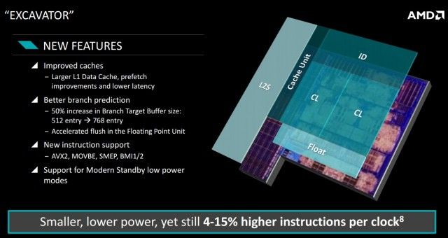
Procesadores para sistemas móviles
Microarquitectura del Bulldozer de 4^{ta} Gen
Características: Memorias cachés mejoradas Cachés de datos L1 más grandes, mejoras en el prefetch y baja latencia Mejor predicción de saltos aumento del 50% del tamaño del branch target buffer 512 entradas→ 768 entradas flush acelerado en la unidad de punto flotante Soporte de nuevas instrucciones AVX2, MOVBE, SMEP, BMI1/2 Soporte de nuevos modos de bajo consumo de energía
Fig. 12 Pequeño, de bajo consume de energía ,
(yet still 4-15% higher instructions per lock)
Microarquitectura Lagarto I

Slide 49
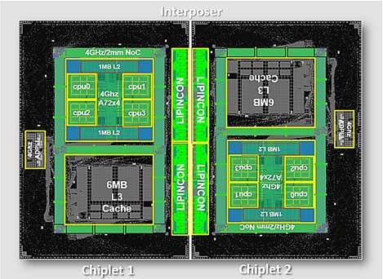
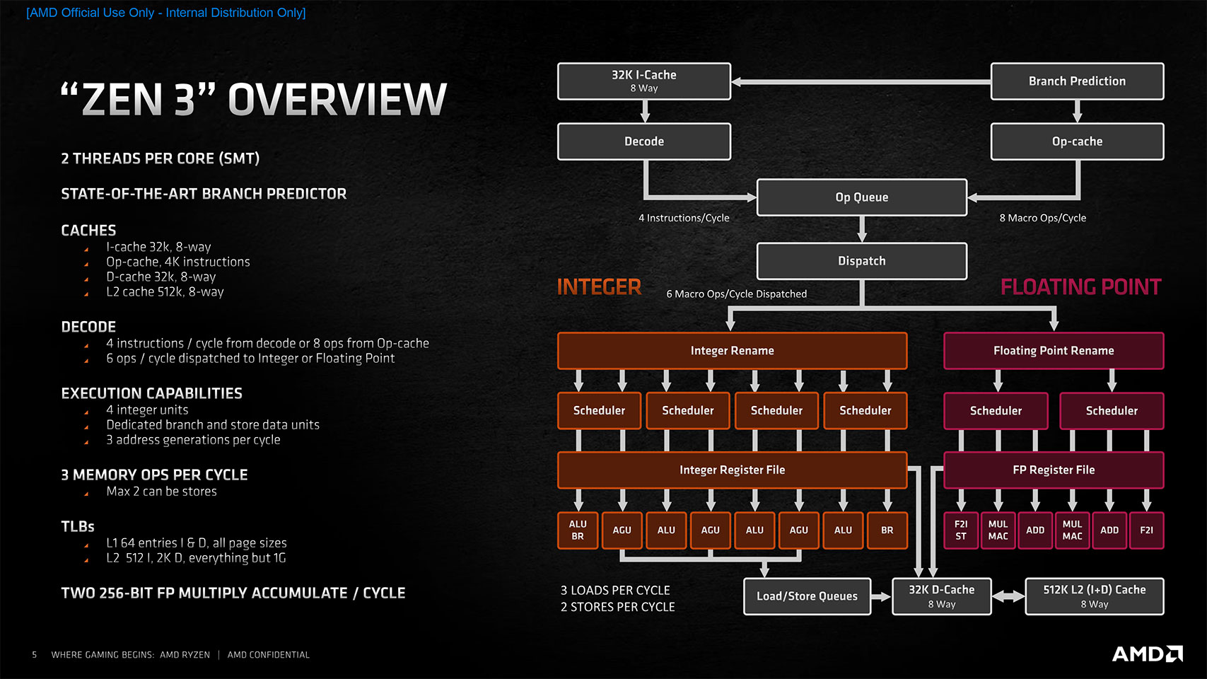
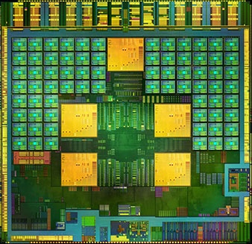
Móviles vs alto desempeño
Arm-based CoWoS (2019)
4 Cores Cortex-A72 Tecnología de 7nm L2 2MB, L3 6MB Fmax. 4 GHz
AMD Ryzen Zen2 (2019)
L1 64 KiB, L2 512 KiB Extension de nuevo conjunto de instrucciones WBNOINVD, CLWB, RDPID, RDPRU, MCOMMIT Mitigaciones de hardware contra vulnerabilidad Spectre Mayor rendimiento y menor consumo que Cascade Lake (Intel)
NVIDIA Tegra 4 (2013)
Cortex A-15 predicción crítica para ejecución fuera de orden Predictor bimodal para reducir penalizaciones por ejecución fuera de orden Cortex-A9 tiene un tamaño mayor para almacenar el historial de saltos y equipararse con el a-15
Microarquitectura Lagarto I

Slide 50
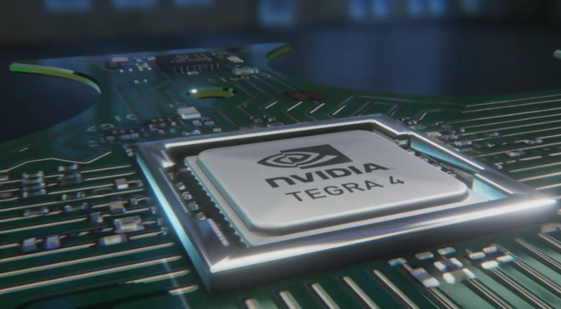
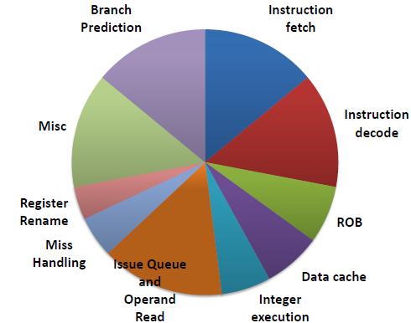
Nvidia tegra-4
consumo de energía
Fig. 13 El NVIDIA Tegra 4 es un SoC basado en ARM y diseñado principalmente para la ejecución de Android y tabletas Windows RT.
CONSUMO DE ENERGÍA POR EL NVIDIA Tegra 4

Slide 51
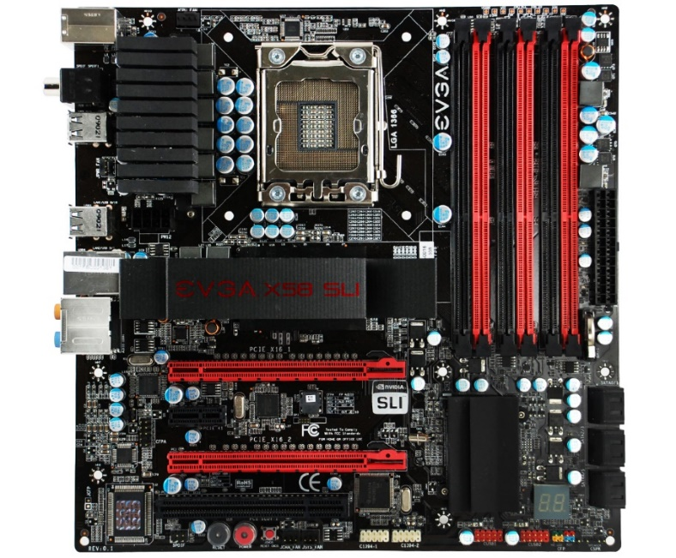
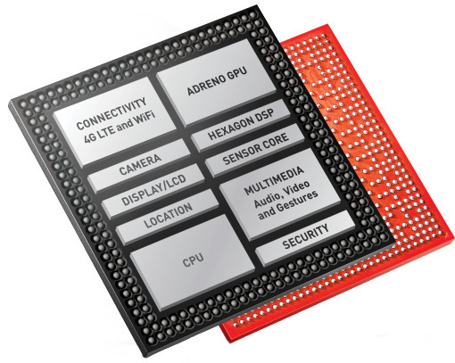
¿Qué es un System-On-Chip ?
SoC
Un System-On-Chip (SoC) es un circuito integrado que incluye los componentes fundamentales de una computadora dentro del mismo chip: CPU, GPU, memorias, controladores, dispositivos de red, etc.
Fig. 1 Tarjeta madre EVGA X58 SLI para un equipo de escritorio.
Fig. 2 Diagrama de un Snapdragon 801 SoC desarrollado por Qualcomm.
La batalla por los sistemas del futuro

Slide 52
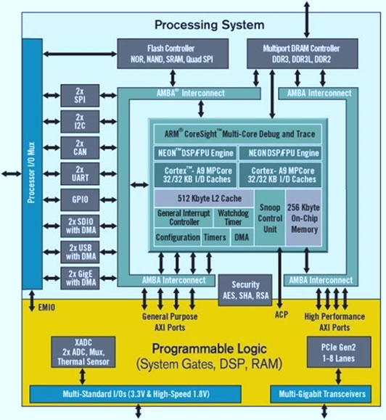
SoC y FPGAS
Flexibilidad
Componentes
Procesador
GPU
Memoria on-chip
Redes de interconexión
Controladores de memoria
Controladores de periféricos
Módulos de conectividad
Aceleradores hardware
Fig. 4 Diagrama del Zynq-7000 desarrollado por Xilinx.
La batalla por los sistemas del futuro

Slide 53
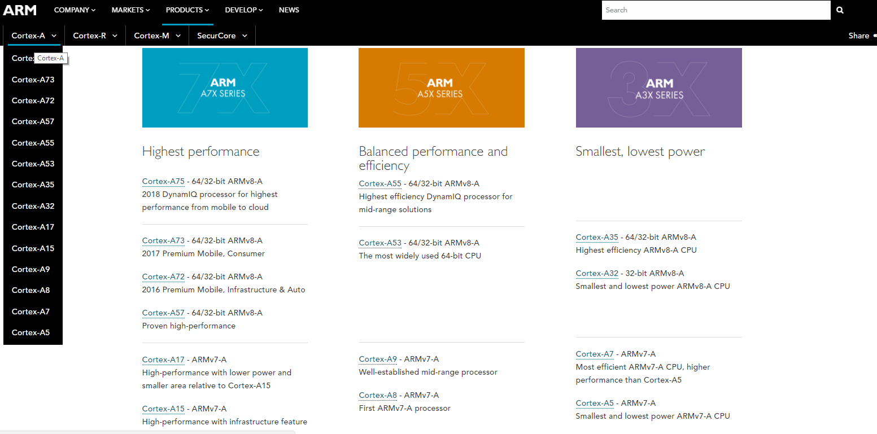
Algunos ejemplos
Procesadores en el mercado
La batalla por los sistemas del futuro

Slide 54
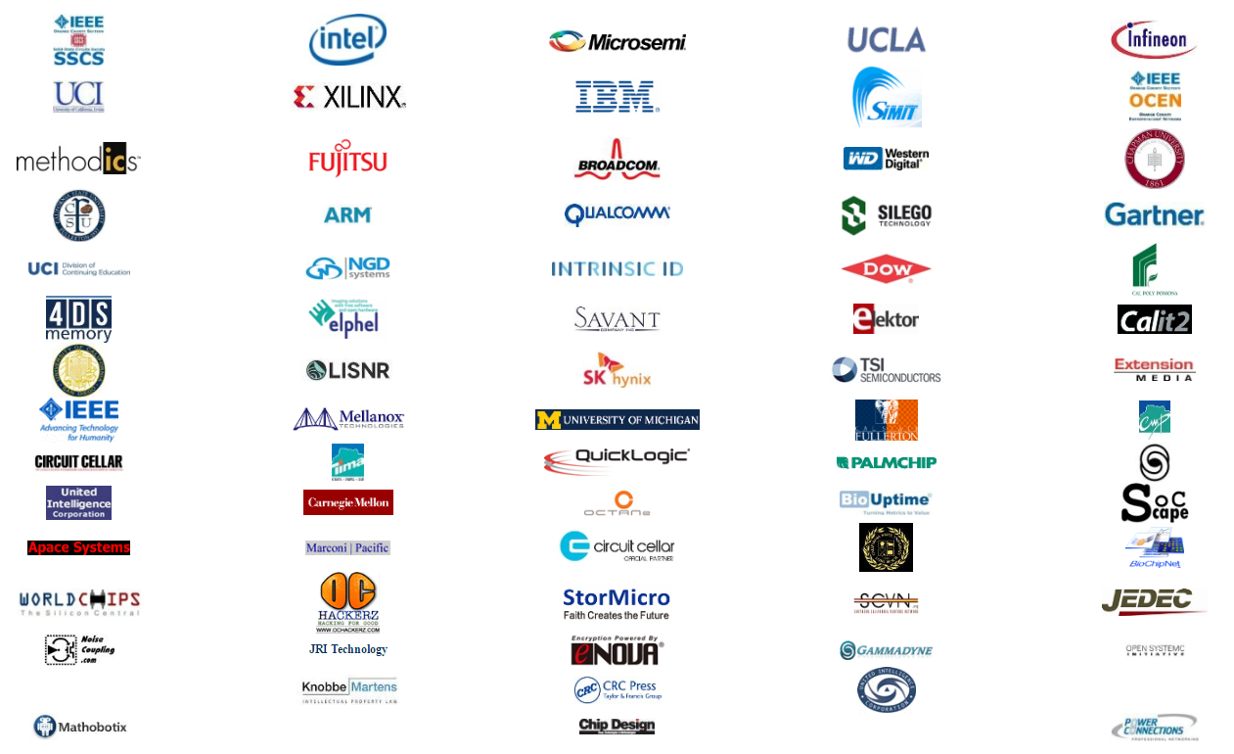
La importancia de los SoC
En la industria
Los SoC ha cobrado relevancia en el mercado de los dispositivos móviles gracias a la reducción en los costos de manufactura de semiconductores, así como en la fuerte relación que existe entre el balance de energía y el desempeño de un sistema.
Fig. 3 Patrocinadores del ‘International System-on-Chip Conference’, edición 2015.
La batalla por los sistemas del futuro

Slide 55
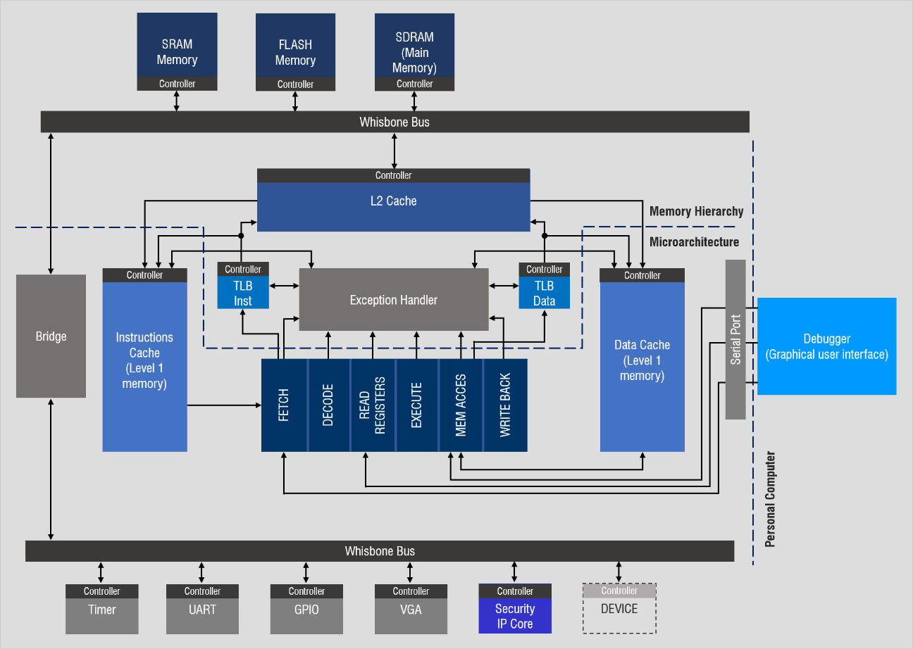
Una mirada a Lagarto I SoC
Fig. 9 Diagrama del SoC Lagarto I.
La batalla por los sistemas del futuro

Slide 56
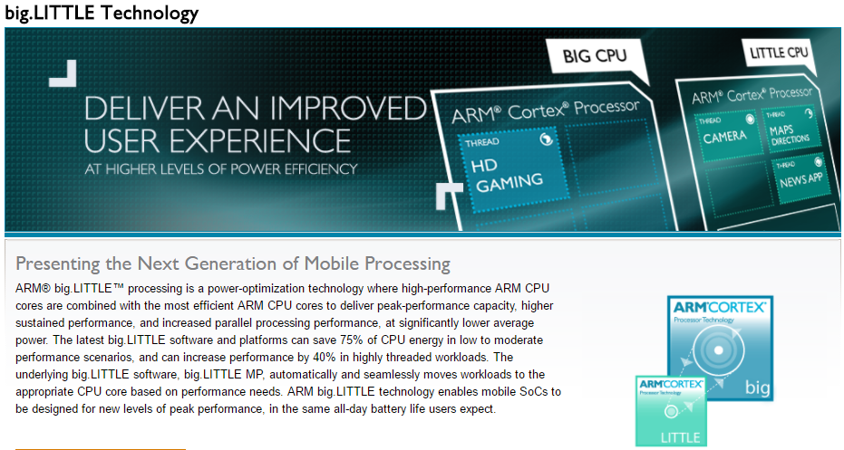
Los nuevos enfoques
La batalla por los sistemas del futuro

Slide 57
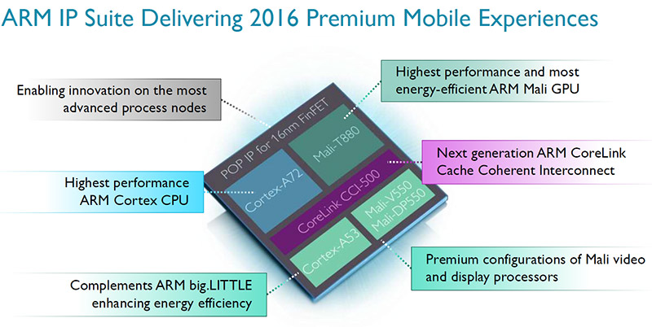
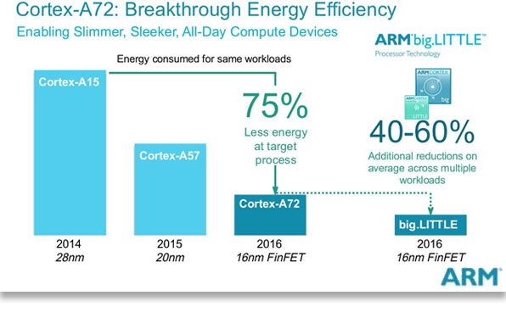
Arquitecturas híbridas
La batalla por los sistemas del futuro

Slide 58
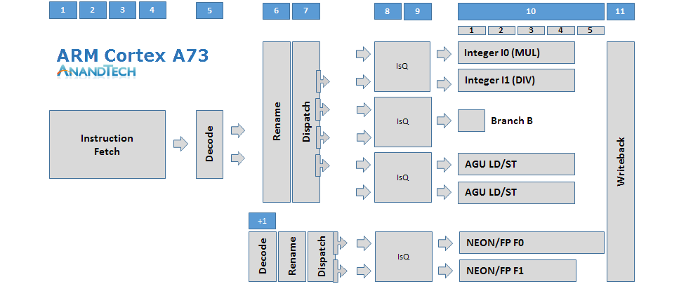
Procesadores de bajo consumo
Arquitectura escalar
Ejecución en orden
Técnicas de planificación dinámica
Predicción de saltos
Fig. 5 Microarquitectura del ARM Cortex-A53.
La batalla por los sistemas del futuro

Slide 59
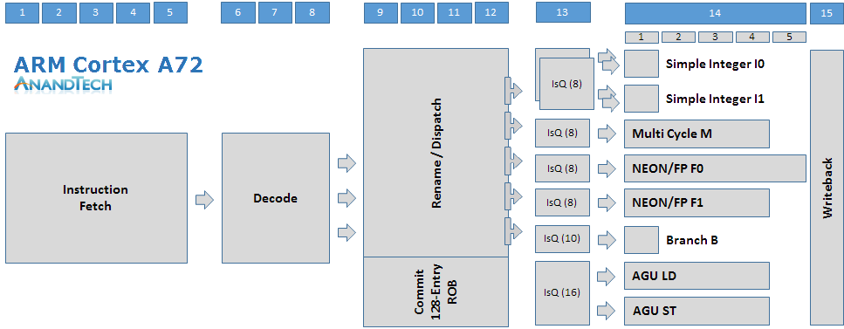
Procesadores de alto desempeño
Arquitectura súper-escalar
Búsqueda, decodificación y emisión de múltiples instrucciones cada ciclo de reloj
Técnicas de planificación dinámica
Predicción de salto
Renombrado de registros
Ejecución fuera de orden
Fig. 7 Microarquitectura del ARM Cortex A72.
La batalla por los sistemas del futuro

Slide 60
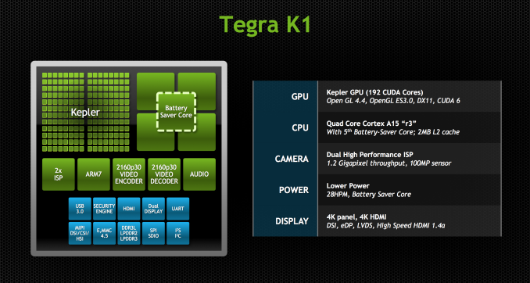
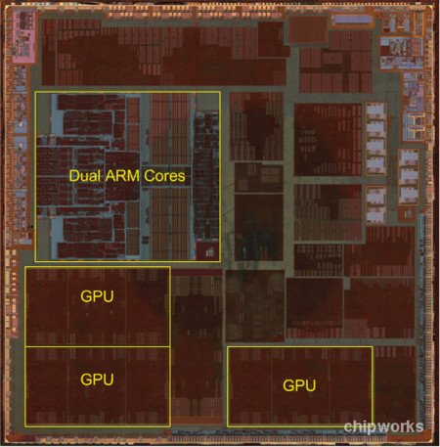
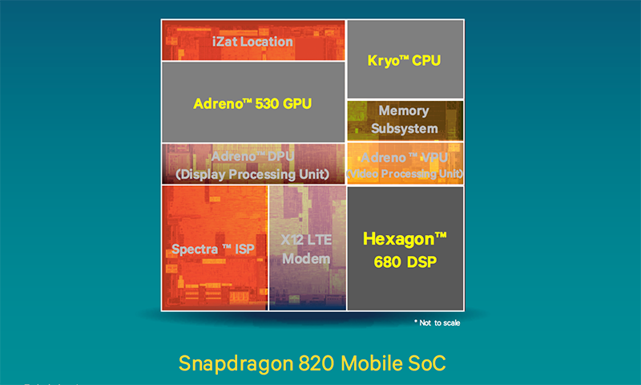
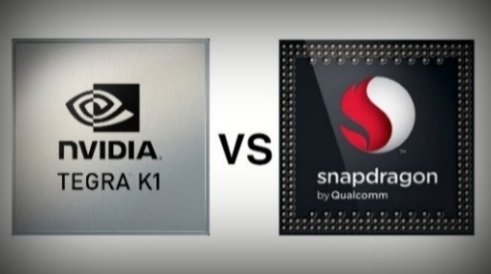
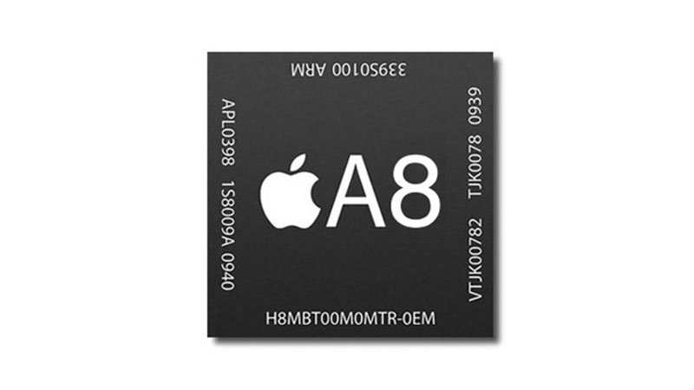
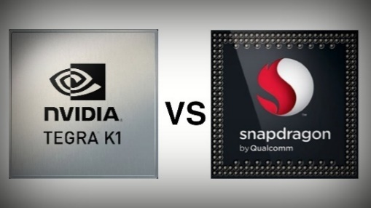
Algunos ejemplos de SoC
QUALCOM Snapdragon 820
ISA: ARMv7-A 32-bits CPU: Cortex A15 Quad-Core CPU Clock Speed: 2.3 GHz GPU: 192 NIVIDIA CUDA Cores
QUALCOM Snapdragon 820
ISA: ARMv8-A 64-bit CPU: Cyclone Dual-Core CPU Clock Speed: 1.4 GHz GPU: PowerVR GX6450
QUALCOM Snapdragon 820
ISA: ARMv8-A 64-bit CPU: Kryo Quad-Core CPU Clock Speed: 2.2 GHz GPU: Ardeno 530
Microarquitectura del Lagarto I
La batalla por los sistemas del futuro

